Slide 1
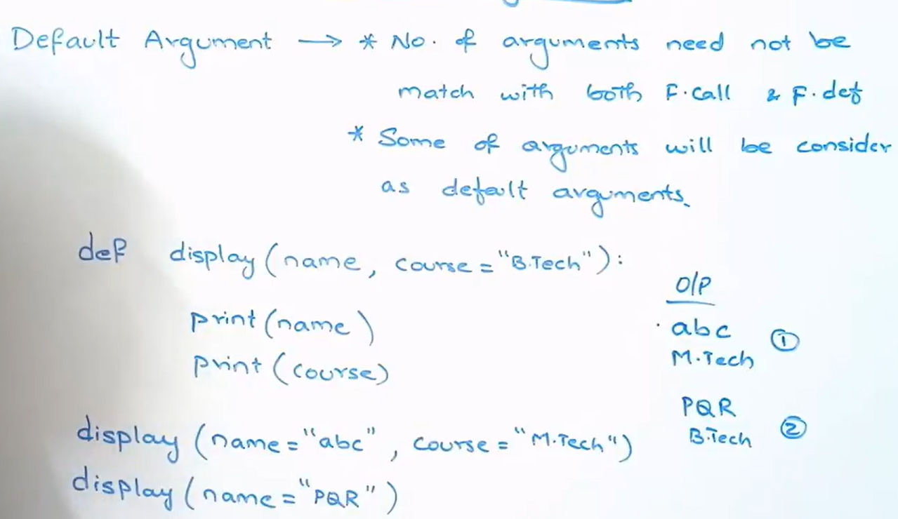

Slide 2


5.4 + 1000 = 1005.4
100 + 1000 = 1100

